Slide 1
Creational Patterns in C#
Nataliia Svystun
Notes:
All 23 design patterns (including 5 creational patterns) were described in book by Gang of four (Erich Gamma, Richard Helm, Ralph Johnson and John Vlissides) in 1994.
But today, today we’re going to talk about only Creational Patterns in C#.

Slide 2
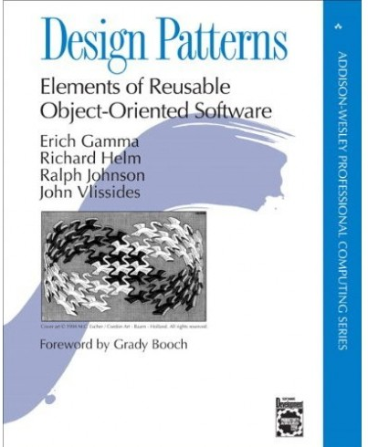
Agenda
Abstract Factory
Builder
Factory Method
Prototype
Singleton
Notes:
We’ll find out about kind of creational patterns such as Abstract Factory, Builder, Factory Method, Prototype, Singleton.
Creational patterns allow you to hide work with specific classes and details how these classes are created and docked. The only known object information is the interfaces of these objects given through abstract classes. This simplifies understanding of the processes of creating objects: when, how, who and what creates.

Slide 3
Agenda
Abstract Factory (Kit)
Builder
Factory Method
Prototype
Singleton
Notes:
So, let’s start.
The Abstract Factory pattern also known as Kit (set of tools).
The Abstract Factory pattern provides the client with an interface (set of methods) to create families of interconnected or interdependent product objects, while hiding from the client information about specific classes of created object-products.

Slide 4

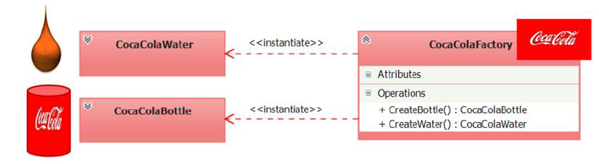
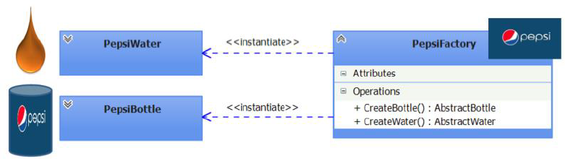
Abstract Factory (Kit)
Notes:
What is a factory in objective reality? A factory is an object having machines (methods) that produce products. For example, the Coca-Cola factory produces sweet soda water poured into tin cans. Suppose that there are two machines in the factory premises. One machine mixes and carbonates the sweet water, and the other machine forms tin cans. After the sweet water and tin can is produced, it is required to pour water into the jar, in other words, it is required to organize the interaction between two products: water and a jar. We describe this process using the UML class diagrams.
The diagram shows that the Coca-Cola factory generates two products: water and a jar. These products must necessarily interact with each other, otherwise water will be problematic to deliver to the consumer, no less than an empty bank the consumer is not needed. Associated products (water and a bank), produced by the Coca-Cola factory, form the family of products of the Coca-Cola factory.
Pepsi's factory also produces its own family of interacting and interdependent products (water and bank).
It is important to note that it is not logical to try to establish interaction between products from different families (for example, pour Coca-Cola water into a Pepsi bank or Pepsi water into a Coca-Cola bank). Most likely both manufacturers will be against such interaction. This approach is an example of an antipattern.

Slide 5
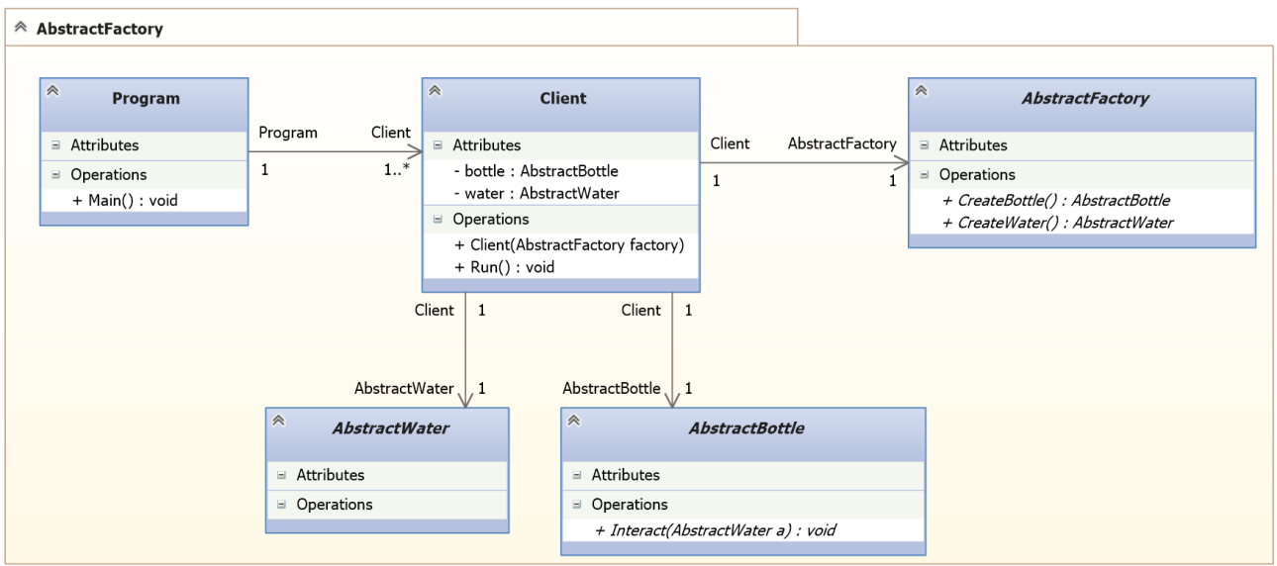
Abstract Factory
Notes:
Represent the reviewed factories and the product families they spawn in the context of one program.
First, you need to create abstract classes for specifying product types (AbstractWater and AbstractBottle) and factory type (AbstractFactory). Describe the interaction interfaces with each type of product and factory.
Next, you need to create a specific Client class in which you abstractly (without implementation) describe the processes for generating instances of product types and options for using these types of products, through their existing abstract interfaces. Also, the Client class implements the idea of ​​encapsulation variations (hiding parts of the software system).

Slide 6
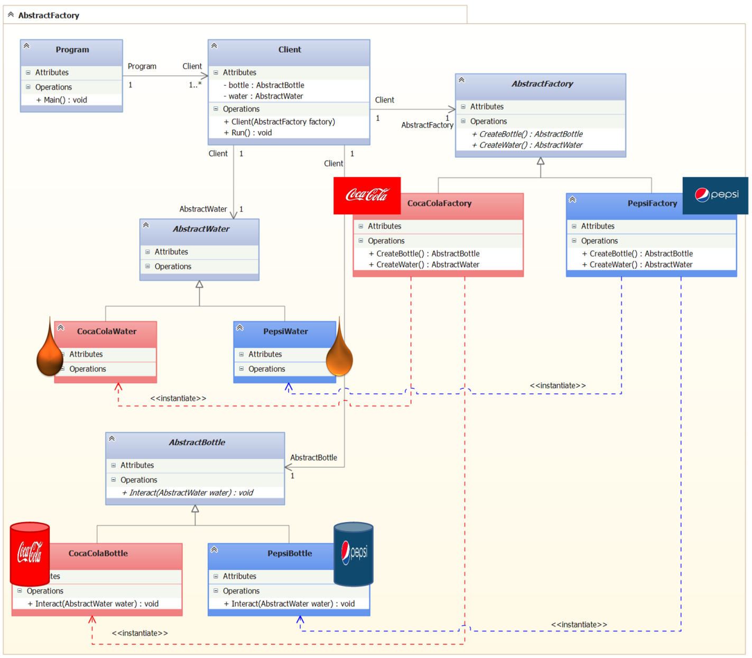

Slide 7
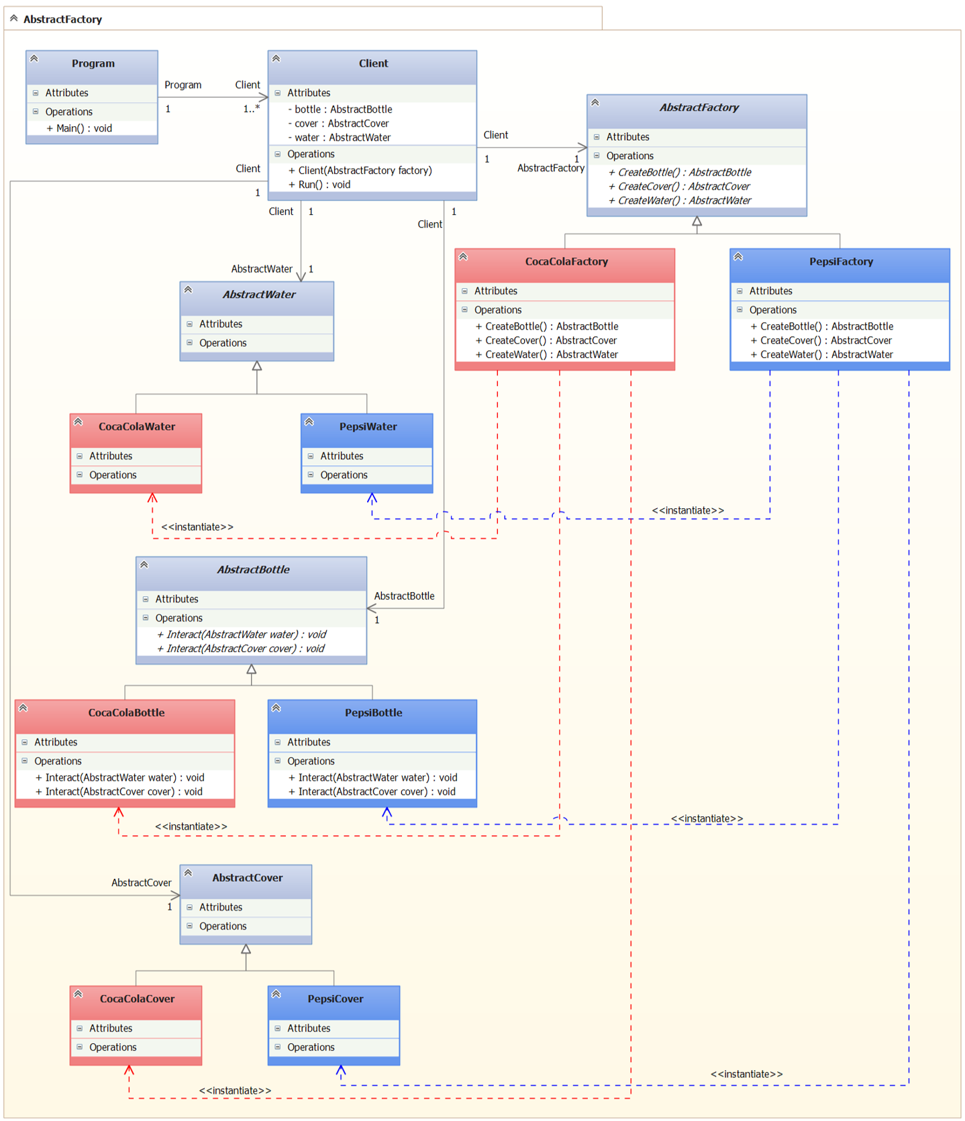
Notes:
Using this approach to product generation, now it is not difficult to add new types of products to the system (for example, the cover for closing the jars with water).

Slide 8
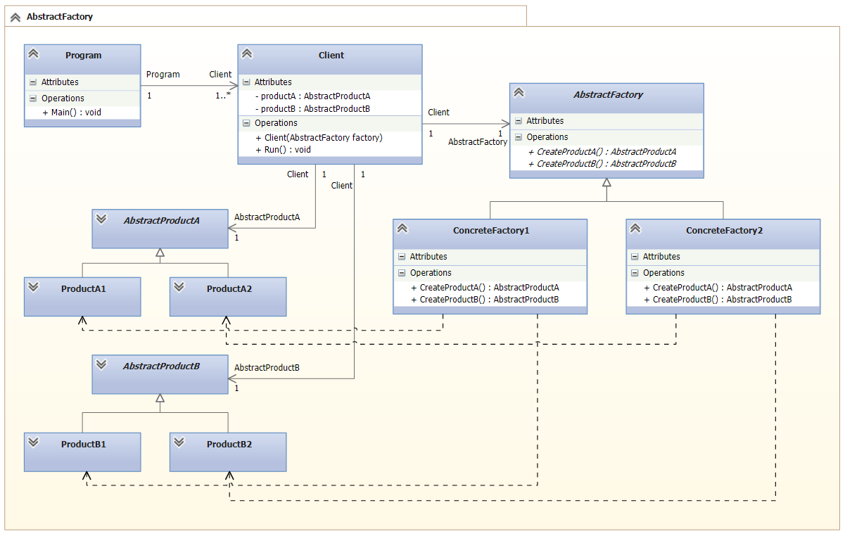
Abstract Factory UML

Slide 9
Abstract Factory
The Abstract Factory pattern has the following advantages:
Hiding work with specific classes of products.
Allows you to easily replace the family of products used.
Ensuring sharing of products.
Abstract Factory pattern has the following disadvantages:
There is a slight inconvenience in adding a new kind of product.
Notes:
The Abstract Factory pattern is recommended when:
It is required to create product objects of different types and establish interaction between them, thus forming families of these product objects. The product objects included in the family must be used together.
It is required to build a subsystem (module or component) in such a way that its internal device (state and / or behavior) is configured when it is created. At the same time, neither the process nor the result of building a subsystem was dependent on the way of creating objects in it, their composition (composing and connecting objects) and representation (adjusting the internal state of objects).
The subsystem or system must be configured (configured) through the use of one of the families of product objects generated by a single factory object.
The Abstract Factory pattern has the following advantages:
Hiding work with specific classes of products.
The factory hides from the client details of the implementation of specific classes and the process of creating instances of these classes. Specific product classes are known only to specific factories and they are not used in client code. The client manages instances of specific classes only through their abstract interfaces.
Allows you to easily replace the family of products used.
An instance of the class of a particular factory is created in the application in one place and only once, which makes it easier to replace the factories in the future. In order to change the family of products used, you just need to create a new instance of the factory class, then the entire family will be replaced at once.
Ensure the sharing of products.
It makes it easy to control the interaction between product objects that are designed for sharing and are part of the same family.
Abstract Factory pattern has the following disadvantages:
There is a slight inconvenience in adding a new kind of product.
To create a new type of products, you will need to create new product classes (abstract and concrete), add a new abstract factory method to the abstract factory class, and implement this abstract method in derived factory-specific factories, and modify the Client class code.

Slide 10
Agenda
Abstract Factory
Builder
Factory Method
Prototype
Singleton
Notes:
The Builder pattern helps to organize the step-by-step construction of a complex product object so that the client does not need to understand the sequence of steps and the internal structure of the product object being built, and as a result of the same design process, product objects with different representations (internal device).

Slide 11
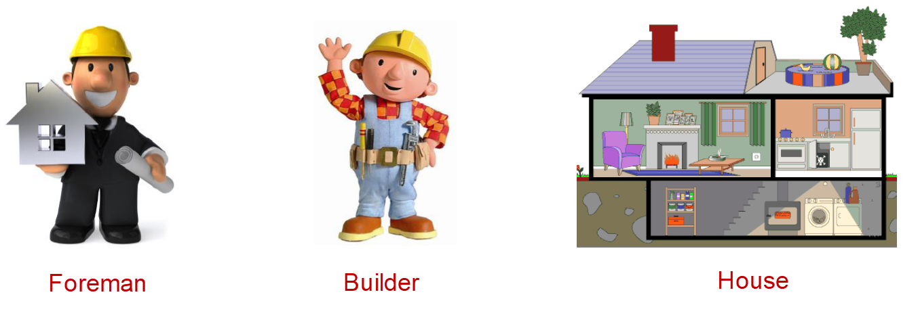
Builder
Who is a builder in objective reality?
Notes:
Who is a builder in objective reality? A builder is a person who builds buildings and structures (bridges, dams, tunnels, etc.). The result of the construction is the erected building (structure). In order for the building to be built according to the rules and in accordance with the design standards, the builders should be managed. The position of the head on the construction site is called the construction superintendent (short for "works"). The foreman instructs the builder how and in what order to carry out construction work. The Builder pattern is built on a similar metaphor.

Slide 12
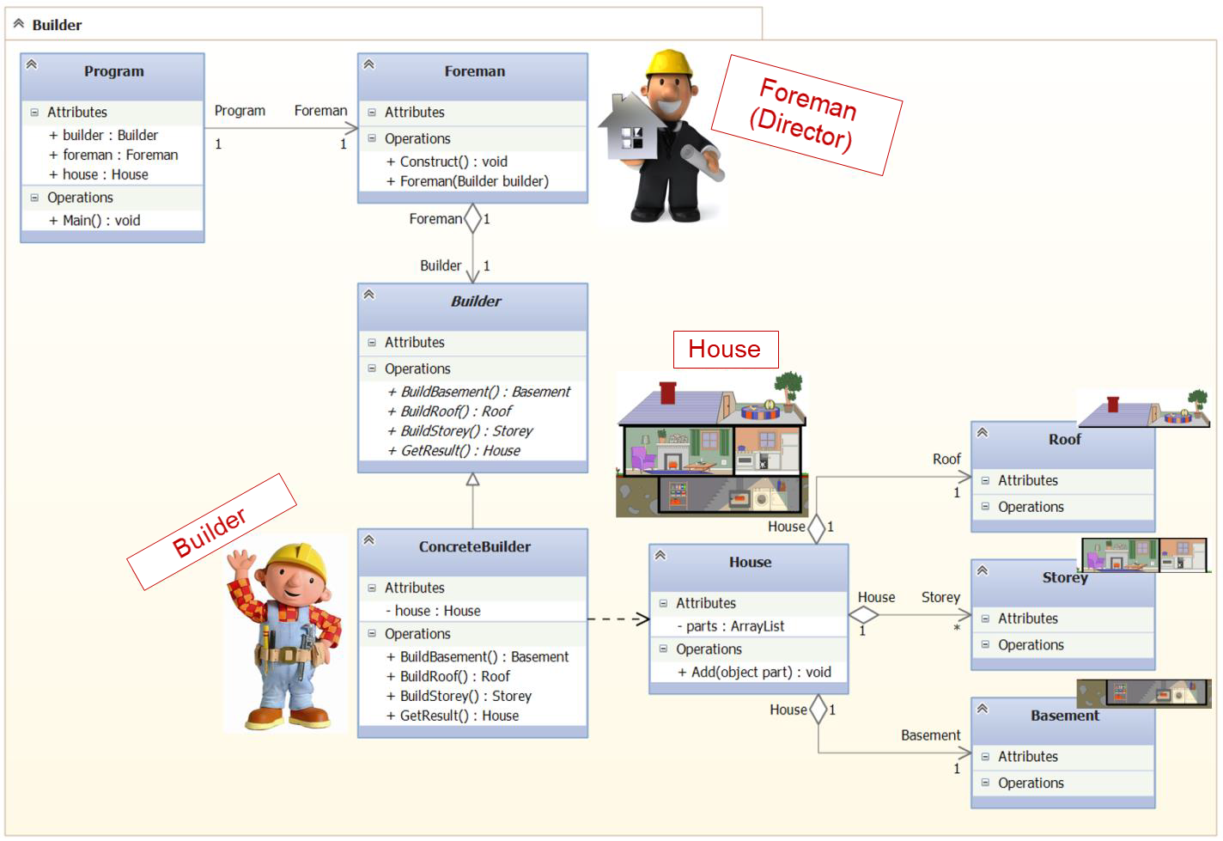
Notes:
Foreman, should give the builder instructions for building parts of the house in a certain sequence. For example:
1. "Build a basement,
2. "Build a storey",
3. "Build a roof".
The method of building a house determines the type of concrete builder. A bricklayer, who builds a house of brick will build a house in a different way, from a carpenter who will build a log house (wooden house) from logs. Thus, according to the project, the foreman must call the appropriate builder and give him the appropriate instructions in a certain order. First, build a basement, then a floor and, last but not least, a roof.

Slide 13
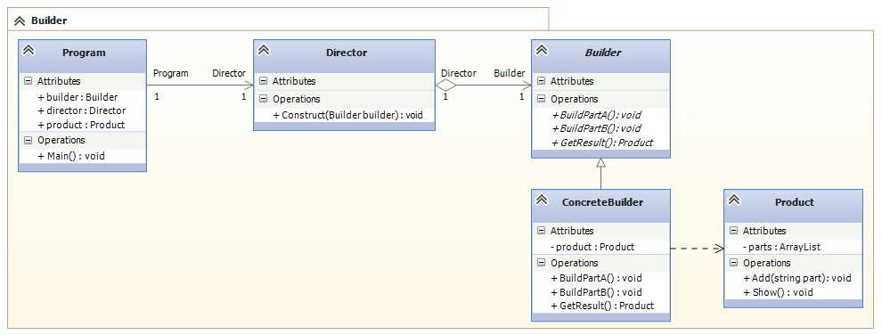
Builder UML

Slide 14
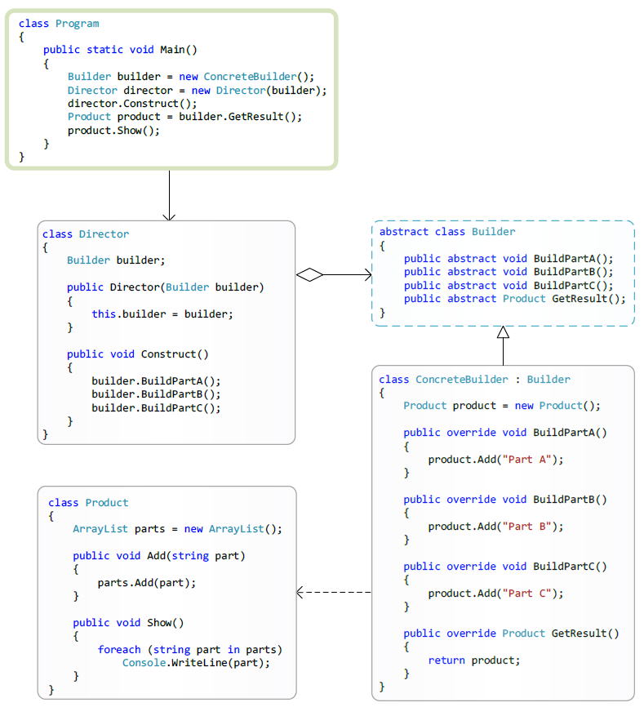
Builder
Notes:
The participants:
Product - It is a class of a complex-constructed product object and contains a set of methods for assembling the final product result from parts. The product class can be linked by relationships of aggregation relations, with classes that describe the constituent parts of the created product.
Builder - Abstract builder:
Provides a set of abstract methods (interface) for creating a product object from parts and getting the finished result.
ConcreteBuilder - Concrete builder:
Constructs a product object by collecting it from parts, implementing the interface specified by the abstract builder (Builder). Provides access to the finished product (returns the product to the client or in a special case to the director).
Director - Director (Manager):
Using the Builder interface, the director instructs the builder to build the product.

Slide 15
Builder
The Builder pattern has the following advantages:
Allows you to change the composition of the product.
Hides the code that implements the construction and presentation.
Provides full control over the process of building the product.
Notes:
The Builder pattern is recommended when:
The algorithm for step-by-step creation of a complex product object should not depend on the parts of the product object and how these parts fit together;
The process of creating a product should provide the possibility of obtaining various variations of the created product.
The Builder pattern has the following advantages:
Allows you to change the composition of the product.
The abstract class Builder provides the director with a set of abstract methods (abstract interface) for managing the construction of the product. Behind the abstract interface, Builder hides the internal structure of the created product and the process of building it. Since the product is built according to the abstract interface, it is enough to create a new type of builder to change the structure of the product;
Hides the code that implements the design and presentation.
The Builder pattern improves modularity by hiding the way that complex objects are constructed and presented. Clients do not know anything about the classes included in the internal structure of the product, the use of these classes is not available in the builder's interface. ConcreteBuilder's concrete builders contain the code needed to create and assemble a particular type of product. The code is written only once and different directors can reuse it to build different product variants from the same parts by combining these parts.
Provides full control over the process of building the product.
Unlike other generative patterns, which immediately construct the entire object-product completely, the builder builds the product step by step under the direction of the director. And only when the construction of the product is completed, the director or client takes it from the builder. Therefore, the builder's interface reflects the process of step-by-step product design more than other generative patterns. This allows you to ensure complete control over the design process, and therefore, over the internal structure (combination of parts) of the finished product.

Slide 16
Agenda
Abstract Factory
Builder
Factory Method
(Virtual Constructor)
Prototype
Singleton
Notes:
The Factory Method pattern also known as Virtual Constructor.
The Factory Method pattern provides an abstract interface (a set of methods) for creating a product object, but leaves the possibility for class developers implementing this interface to decide on their own which instance of a specific product class to create. The Factory Method pattern allows the underlying abstract classes to transfer responsibility for creating product objects to their derived classes.

Slide 17
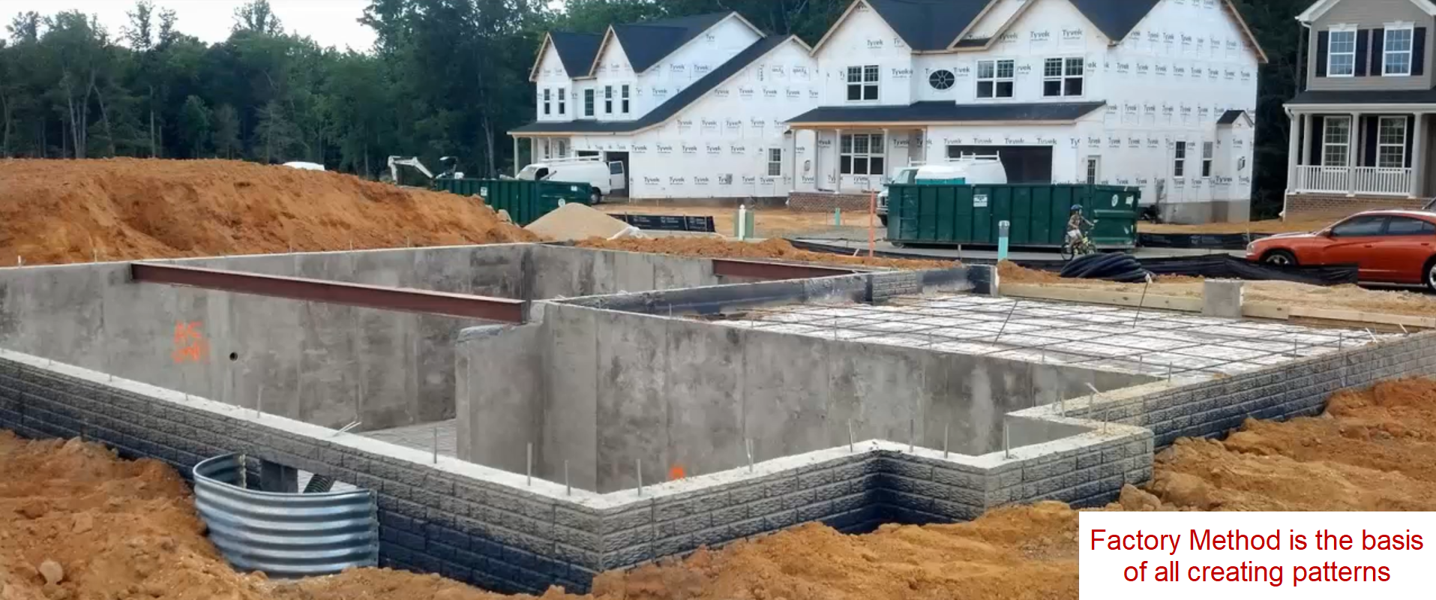
Factory Method
(Virtual Constructor)
Notes:
The Factory Method pattern underlies all creating patterns, organizing the process of creating product objects. If the designer at the design stage of the system can not immediately determine the appropriate pattern for organizing the process of creating the product in a particular situation, then first use the Factory Method pattern.
For example, if the designer does not determine the complexity of the product or the need and method of organizing the interaction between several products, then it makes sense to first use the Factory Method pattern. Later, when the requirements are formulated more clearly, it will be possible to quickly replace the Factory Method pattern with another generating pattern that is more appropriate for the design situation.
The main task of the Factory Method pattern is to organize the technique of delegating responsibility for creating product objects with one class (often abstract) to another class (derived from a particular class). In other words, an abstract class containing an abstract factory method, tells its derivative to a particular class: "A concrete class, I instruct your developer to choose a specific class of the generated product object independently when implementing my abstract factory method."

Slide 18
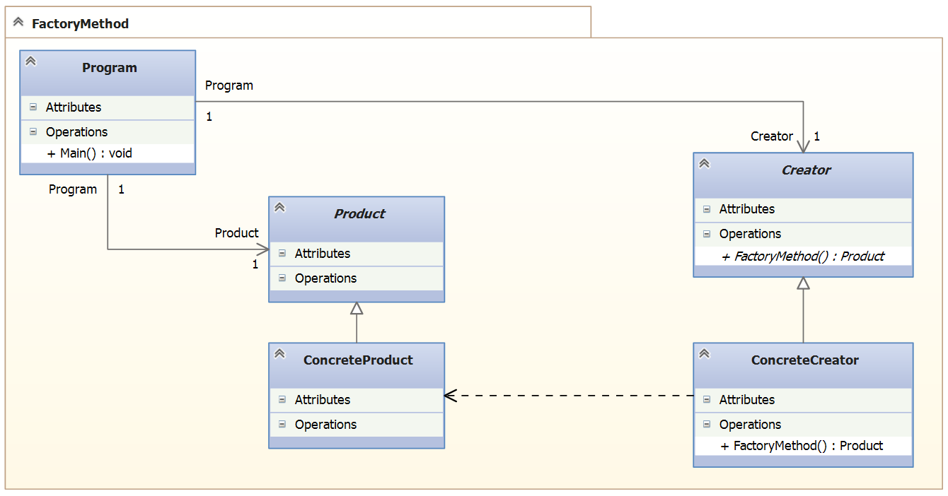
Factory Method UML

Slide 19
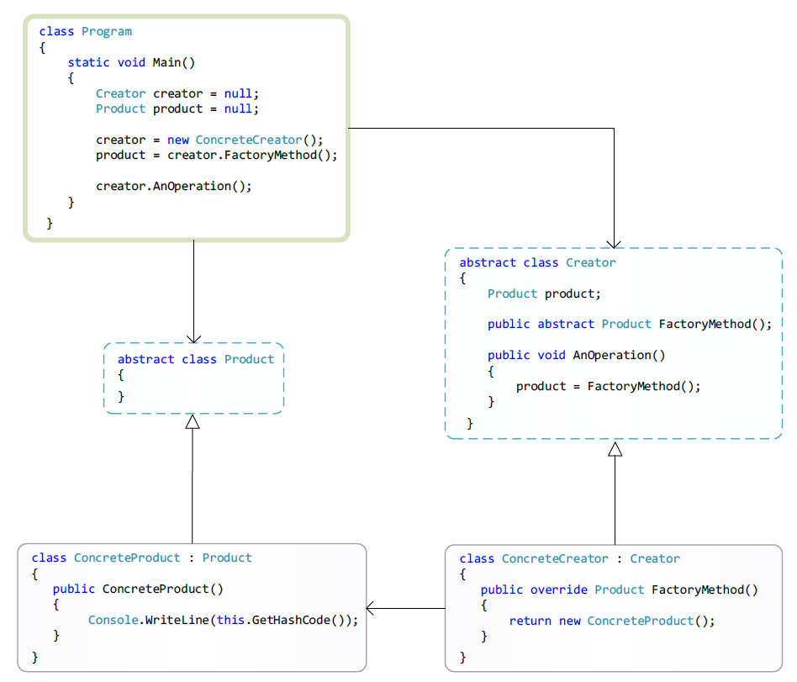

Slide 20
Factory Method
The Factory Method pattern has the following advantages:
Notes:
The Builder pattern is recommended when:
The algorithm for step-by-step creation of a complex product object should not depend on the parts of the product object and how these parts fit together;
The process of creating a product should provide the possibility of obtaining various variations of the created product.
The Builder pattern has the following advantages:
Allows you to change the composition of the product.
The abstract class Builder provides the director with a set of abstract methods (abstract interface) for managing the construction of the product. Behind the abstract interface, Builder hides the internal structure of the created product and the process of building it. Since the product is built according to the abstract interface, it is enough to create a new type of builder to change the structure of the product;
Hides the code that implements the design and presentation.
The Builder pattern improves modularity by hiding the way that complex objects are constructed and presented. Clients do not know anything about the classes included in the internal structure of the product, the use of these classes is not available in the builder's interface. ConcreteBuilder's concrete builders contain the code needed to create and assemble a particular type of product. The code is written only once and different directors can reuse it to build different product variants from the same parts by combining these parts.
Provides full control over the process of building the product.
Unlike other generative patterns, which immediately construct the entire object-product completely, the builder builds the product step by step under the direction of the director. And only when the construction of the product is completed, the director or client takes it from the builder. Therefore, the builder's interface reflects the process of step-by-step product design more than other generative patterns. This allows you to ensure complete control over the design process, and therefore, over the internal structure (combination of parts) of the finished product.

Slide 21
Agenda
Abstract Factory
Builder
Factory Method
Prototype
Singleton

Slide 22
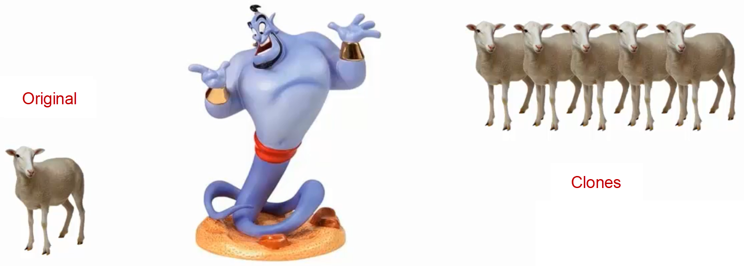
Prototype

Slide 23
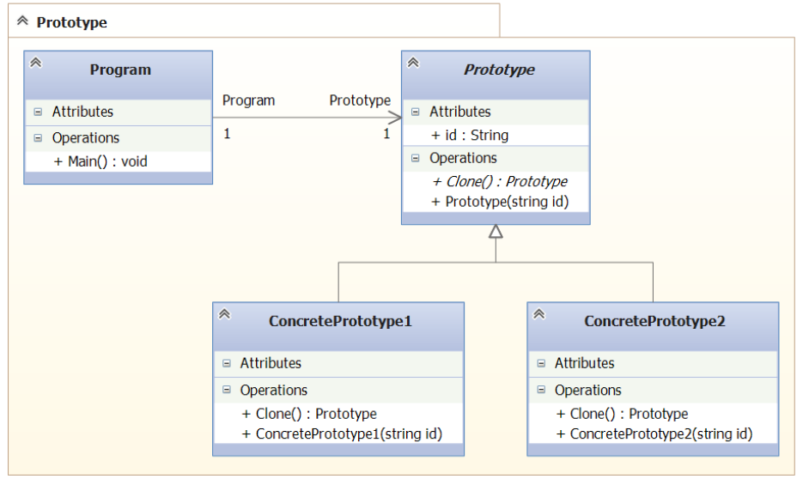
Prototype UML

Slide 24
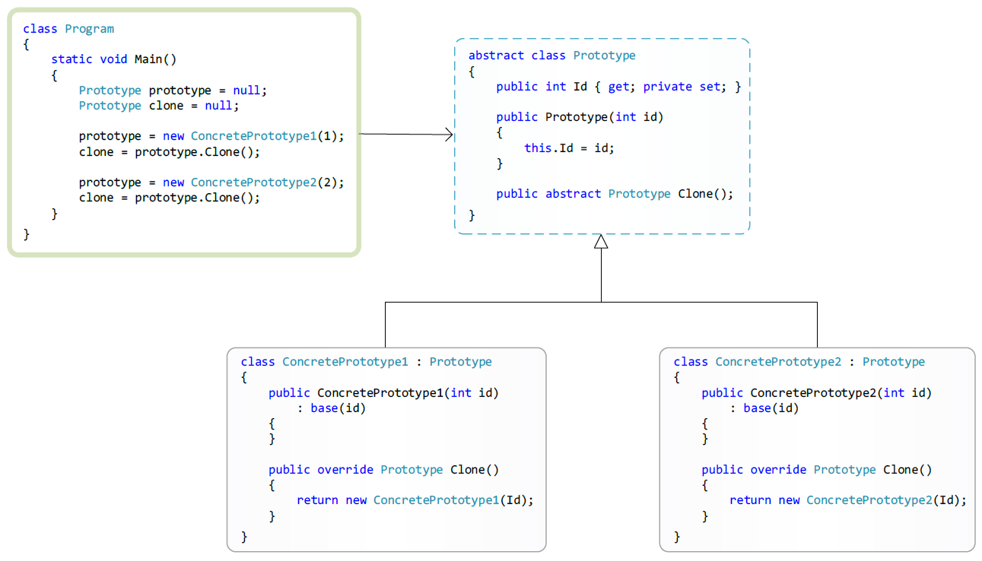
Prototype UML

Slide 25
Prototype
The Prototype pattern has the following advantages:
Notes:
The Builder pattern is recommended when:
The algorithm for step-by-step creation of a complex product object should not depend on the parts of the product object and how these parts fit together;
The process of creating a product should provide the possibility of obtaining various variations of the created product.
The Builder pattern has the following advantages:
Allows you to change the composition of the product.
The abstract class Builder provides the director with a set of abstract methods (abstract interface) for managing the construction of the product. Behind the abstract interface, Builder hides the internal structure of the created product and the process of building it. Since the product is built according to the abstract interface, it is enough to create a new type of builder to change the structure of the product;
Hides the code that implements the design and presentation.
The Builder pattern improves modularity by hiding the way that complex objects are constructed and presented. Clients do not know anything about the classes included in the internal structure of the product, the use of these classes is not available in the builder's interface. ConcreteBuilder's concrete builders contain the code needed to create and assemble a particular type of product. The code is written only once and different directors can reuse it to build different product variants from the same parts by combining these parts.
Provides full control over the process of building the product.
Unlike other generative patterns, which immediately construct the entire object-product completely, the builder builds the product step by step under the direction of the director. And only when the construction of the product is completed, the director or client takes it from the builder. Therefore, the builder's interface reflects the process of step-by-step product design more than other generative patterns. This allows you to ensure complete control over the design process, and therefore, over the internal structure (combination of parts) of the finished product.

Slide 26
Agenda
Abstract Factory
Builder
Factory Method
Prototype
Singleton (Solitaire)

Slide 27

Singleton (Solitaire)

Slide 28
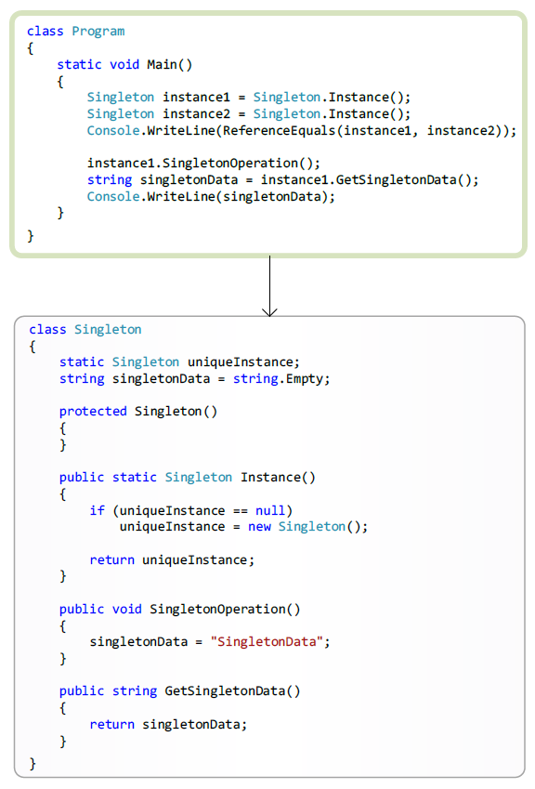
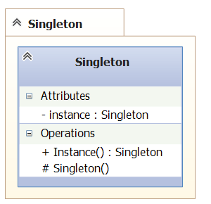
Singleton UML

Slide 29
Singleton
The Singleton pattern has the following advantages:
Notes:
The Singleton pattern is recommended when:
The algorithm for step-by-step creation of a complex product object should not depend on the parts of the product object and how these parts fit together;
The process of creating a product should provide the possibility of obtaining various variations of the created product.
The Singleton pattern has the following advantages:
Allows you to change the composition of the product.
The abstract class Builder provides the director with a set of abstract methods (abstract interface) for managing the construction of the product. Behind the abstract interface, Builder hides the internal structure of the created product and the process of building it. Since the product is built according to the abstract interface, it is enough to create a new type of builder to change the structure of the product;
Hides the code that implements the design and presentation.
The Builder pattern improves modularity by hiding the way that complex objects are constructed and presented. Clients do not know anything about the classes included in the internal structure of the product, the use of these classes is not available in the builder's interface. ConcreteBuilder's concrete builders contain the code needed to create and assemble a particular type of product. The code is written only once and different directors can reuse it to build different product variants from the same parts by combining these parts.
Provides full control over the process of building the product.
Unlike other generative patterns, which immediately construct the entire object-product completely, the builder builds the product step by step under the direction of the director. And only when the construction of the product is completed, the director or client takes it from the builder. Therefore, the builder's interface reflects the process of step-by-step product design more than other generative patterns. This allows you to ensure complete control over the design process, and therefore, over the internal structure (combination of parts) of the finished product.

Slide 30
Questions?

